Slide 1
THE THERAC-25 - A SOFTWARE FATAL FAILURE
Kpea, Aagbara Saturday
SYSM 6309
Spring ’12
UT-Dallas

Slide 2
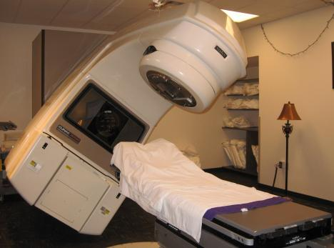
What is the Therac-25
The Therac-25 was a medical linear accelerator, used to treat cancer
patients to remove tumors.

Slide 3
Background Information
Early1970’s, AECL (Atomic Energy of Canada Limited)and a French Company (CGR) collaborate to build Medical Linear Accelerators (linacs).
They develop Therac-6, and Therac-20.
AECL and CGR end their working relationship in 1981.
In 1976, AECL develops the revolutionary "double pass" accelerator which leads to the development of Therac-25.
In March, 1983, AECL performs a safety analysis of Therac-25 which apparently excludes an analysis of software.

Slide 4
Background info …
July 29,1983, the Canadian Consulate General announces the introduction of the new "Therac 25" Machine manufactured by AECL Medical, a division of Atomic Energy of Canada Limited.
Medical linear accelerators (linacs) known generally as “Therac-25”.

Slide 5
How Therac-25 works: Generating an Electron Beam
Linear accelerator works just like the computer monitor
The electrons are accelerated by the gun in the back of the monitor and directed at the inside of the screen
A medical linear accelerator produces a beam of electrons about 1,000 times more powerful than the standard computer monitor
Medical linear accelerators accelerate electrons to create high-energy beams that can destroy tumors with minimal impact on surrounding healthy tissue
The Therac-25 is designed to fold beam back and forth in order to produce long acceleration to fit into smaller space

Slide 6
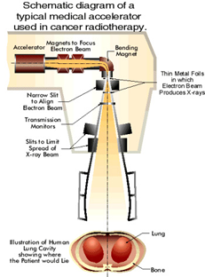
Getting the Beam into the Body
Shallow tissue is treated with accelerated electrons
Scanning magnets placed in the way of the beam; the spread of the beam (and thus its power) could be controlled by a magnetic fields generated by these magnets
Deeper tissue is treated with X-ray photons
The X-ray beam is flattened by a device in the machine to direct the appropriate intensity to the patient.
Beams kill (or retard the growth of) the cancerous tissues

Slide 7
Accident with Therac-25
At East Texas Cancer Center in Tyler, Texas, a
patient complains of a bright flash of light, heard a frying, buzzing sound, and felt a thump and heat like an electric shock.
This indicates radiation overdose by Therac-25 machines after cancer treatment session
A few days after the unit was put back into operation, another patient complained that his face felt like it was on fire.
Another potential overdose of radiation beam by Therac-25.
Both patients died after 4months and 3 weeks respectively due to administered overdose of radiation

Slide 8
Accidents with Therac-25 … contd
At Yakima Valley, Washington in January 1987, another incident of overdose with Therac-25 occurred
Performed two film exposures
Patient developed severe striped burns after treatments, an indication of overdose
Patient died in April as a result

Slide 9
Reasons for the cause of the accidents
At Texas facility;
Operator selected x-rays by mistake, used cursor keys to change to electrons
Machine tripped with “Malfunction 54”
– Documentation explains this is “dose input 2” error
Operator saw “beam ready” proceeded; machine tripped again
At Washington facility;
Operator used hand controls to rotate table to field-light position & check alignment
Operator set machine but forgot to remove film
Operator turned beam on, machine showed no dose and displayed fleeting message
Operator proceeded from pause; After another machine pause, operator reentered room

Slide 10
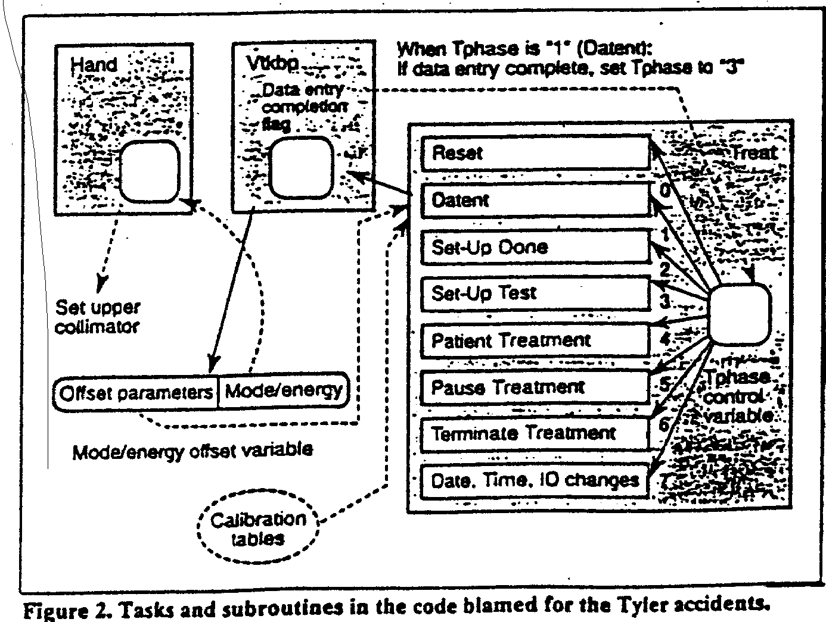
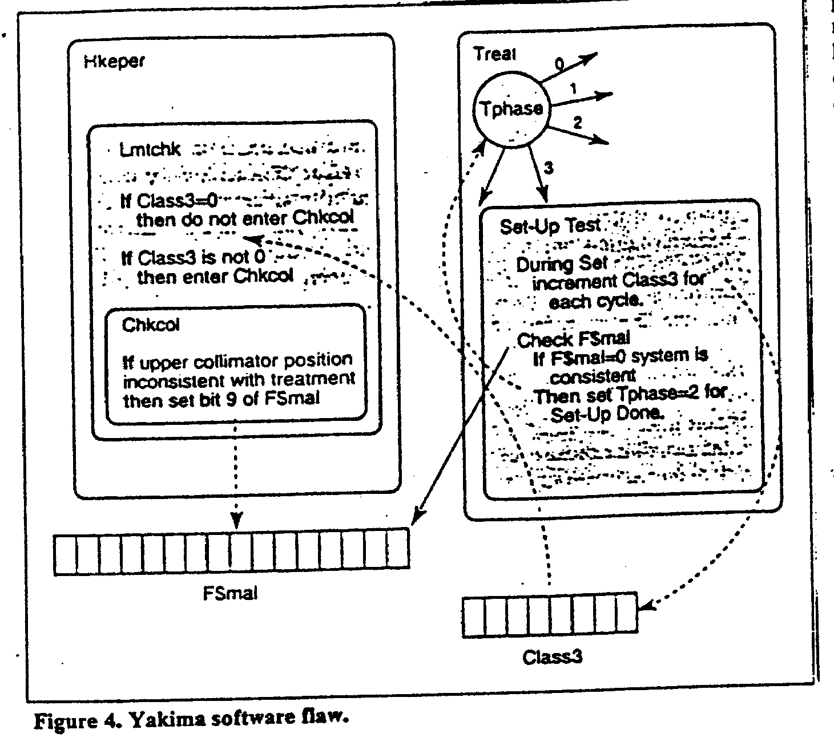
Accidents Race Condition
Source: http://www.cs.jhu.edu

Slide 11
Root Cause Analysis of the Accidents
Software code was not independently reviewed.
AECL did not consider the design of the software during its assessment of how the machine might produce the desired results and what failure modes existed. –No proper risk assessment followed.
The system noticed that something was wrong and halted the X-ray beam, but merely displayed the word "MALFUNCTION" followed by a number from 1 to 64. The user manual did not explain or even address the error codes, so the operator pressed the P key to override the warning and proceed anyway.
AECL personnel, as well as machine operators, initially did not believe complaints. This was likely due to overconfidence
AECL had never tested the Therac-25 with the combination of software and hardware until it was assembled at the hospital.
The problem was a race condition produced by a flaw in the software programming.
Management inadequacies and lack of procedures for following through on all reported incident.
The engineer had reused software from older models. These models had hardware interlocks that masked their software defects

Slide 12
Requirements Issues
Error messages provided by Therac-25 monitor are not helpful to operators
Machine pauses treatment but does not indicate reason why
The equipment control task did not properly synchronize with the operator interface task, so that race conditions occurred if the operator changed the setup too quickly.
Software is required to monitor several activities simultaneously in real time
Interaction with operator
Monitoring input and editing changes from an operator
Updating the screen to show the current status of machine
There were no independent checks that the software was operating correctly (verification)

Slide 13
Requirements Issues … contd
Traceability matrix: ways to get information about errors, i.e., software audit trails should be designed into the software from the beginning.
The software should be subjected to extensive testing and formal analysis at the module and software level.
System testing alone is not adequate; verification would be very valuable.
Involve users at all phases of product development

Slide 14
Corrective Action Plan
Documentation should not be an afterthought.
Software quality assurance practices and standards should be established.
Designs should be kept simple and ensure user-friendly interfaces

Slide 15
Lessons
Complacency
Assumption that problem was understood without adequate evidence
Sole reliance on software for safety
Systems engineering practices need proper coordination

Slide 16
References
The Therac-25 Accidents (PDF), by Nancy G. Leveson (the 1995 update of the IEEE Computer article)
http://en.wikipedia.org/wiki/Therac-25
Jacky, Johathan. "Programmed for Disaster." The Sciences 29 (1989) : 22-27.
Leveson, Nancy G., and Clark S. Turner. "An Investigation of the Therac-25 Accidents." Computer July 1993 : 18-41.

